Slide 1
Exploration for Lightweight Monocular Depth Estimation
CS577-DL
2023/11/10
Wenxuan Zhang

Slide 2
Monocular depth estimation
Depth estimation is a computer vision and technology used to determine the three-dimensional spatial position or depth information of individual objects or objects in an image or scene. Restore the three-dimensional position or shape of an object in the real world by analyzing 2D images for better understanding and processing of the scene Monocular depth estimation Inference of depth information about objects in the scene from a single image. Due to the simplicity, flexibility and low cost of monocular cameras, monocular depth estimation has become a hot topic in monocular depth estimation research in recent years Useful
Help the robot perceive information about the three-dimensional world Wide range of applications: robotics, autonomous driving, virtual reality, photography and video editing...

Slide 3
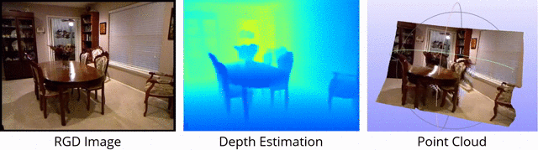
Objectives
Predict the depth value (distance information) of each pixel from a single RGB image. This gives us an estimate of the 3D structure of the scene.

Slide 4
Relationships with other relevant areas
machine learning
Computer vision
3D vision
Deep learning
Depth estimation
3D reconstruction
Monocular
Two-eyed

Slide 5
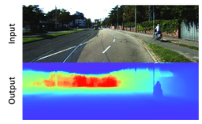
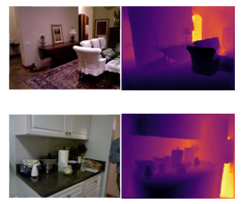
Dataset
KITTI Dataset: The KITTI dataset is one of the most widely used datasets for autonomous driving and visual navigation research. It contains multiple sequences from City Street View, each of which includes binocular images, monocular images, depth images, and camera and lidar parameters. NYU Depth Dataset: The NYU Depth dataset contains depth images from indoor scenes, with over 400,000 RGB images. The NYU Depth dataset has a variety of place, including indoor homes and offices.

Slide 6
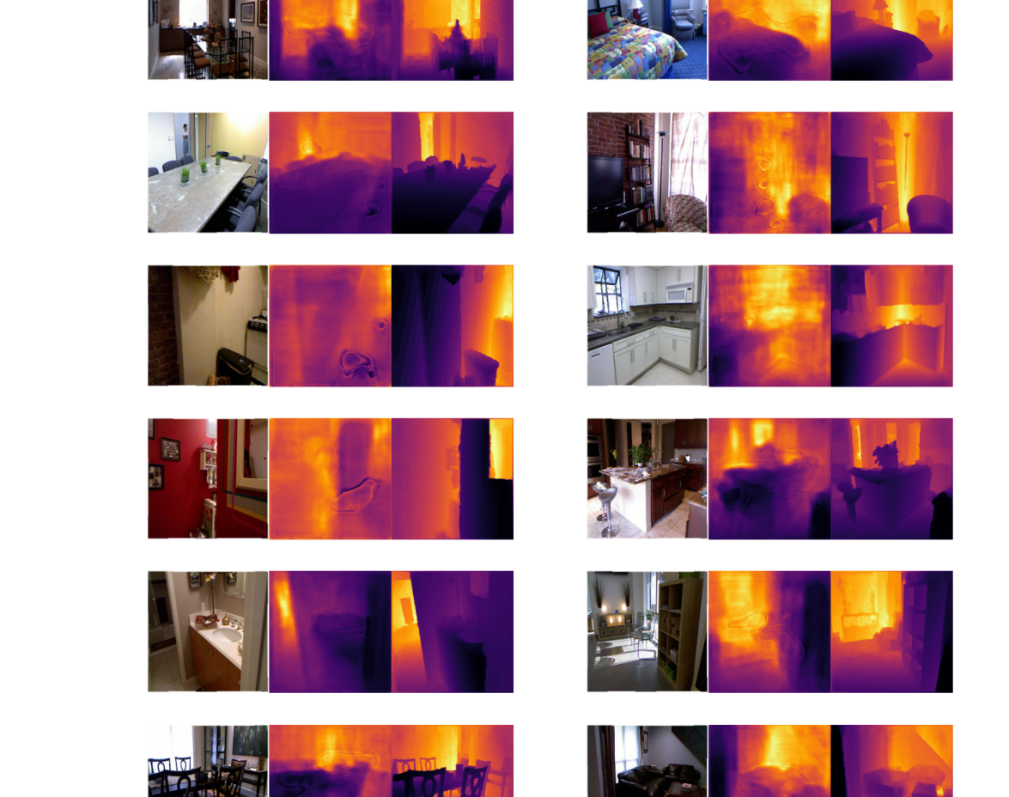
Result

Slide 7
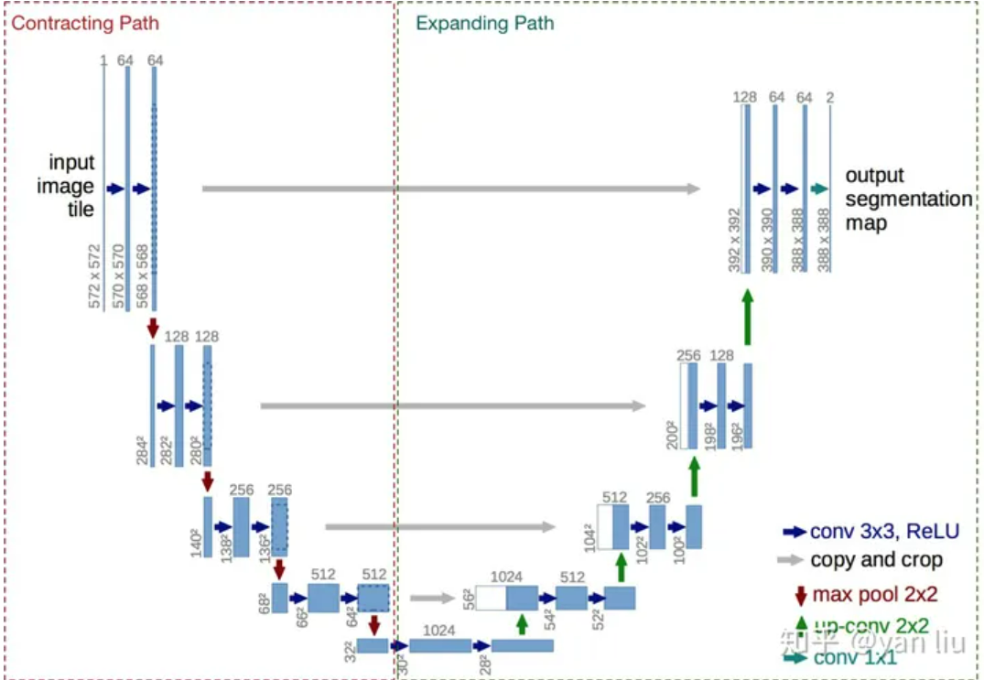
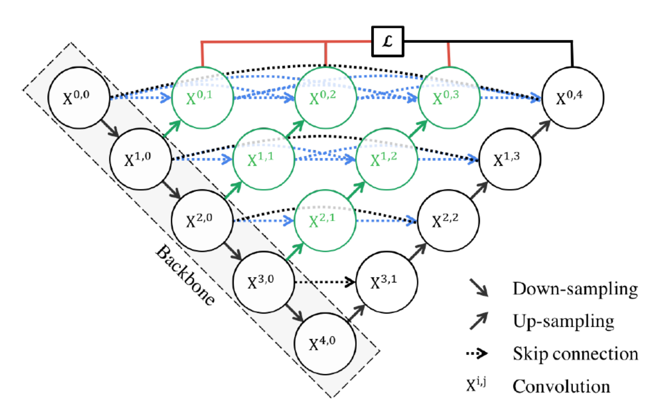
U-net Model
U-net PlusPlus Model

Slide 8
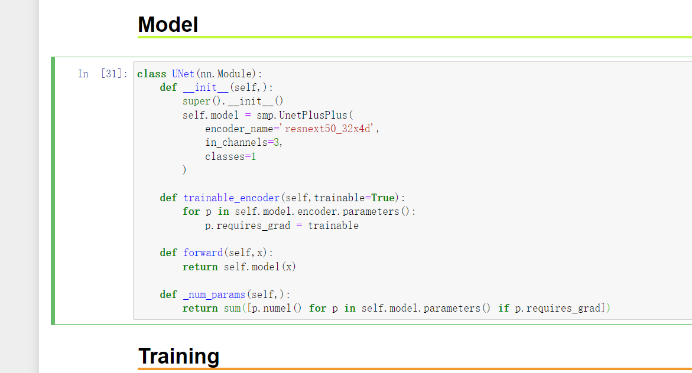
Model
I use the powerful and efficient ResNeXt50_32x4d as our encoder.

Slide 9
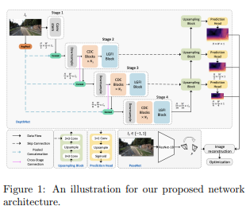
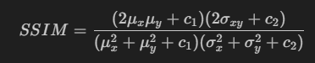
Model Architecture
Explore the possibility to further improve the performance of efficient self-supervised monocular depth estimation, in the following aspects:
• Higher accuracy.
• Lower time-lag and better real-time prediction.
• Less calculation and lower resource consumption.
• Less dependency on the training data.
• Better generalization ability. An illustration for our proposed network architecture is depicted as in Figure 1.

Slide 10
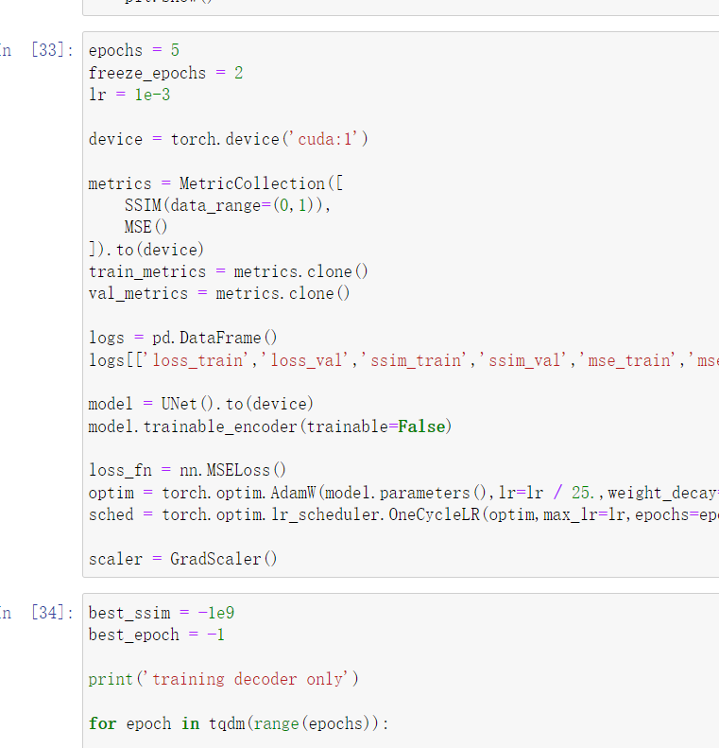
The trainable_encoder function offers us the flexibility to fine-tune the encoder parameters
This allows us to freeze the encoder during the initial training phase to speed up convergence or thaw the encoder for end-to-end training to improve performance as needed.

Slide 11
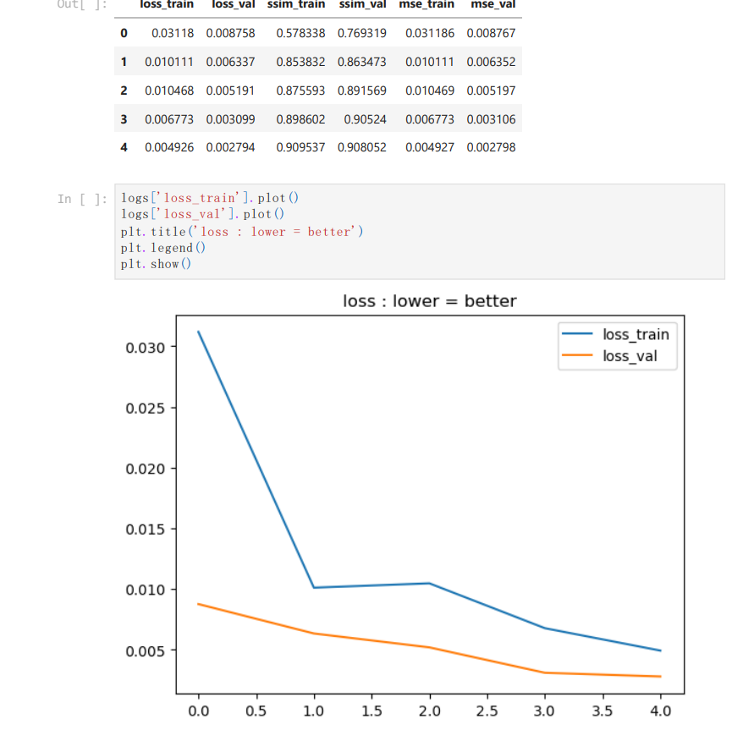
In Jupyter notebook show Loss result

Slide 12
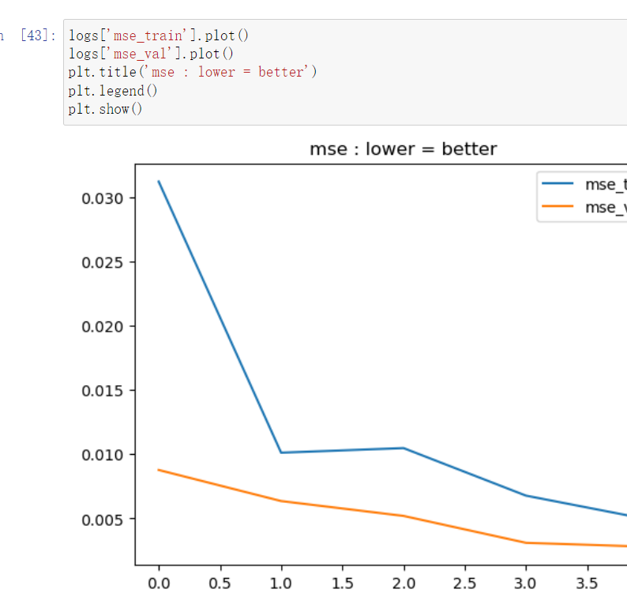
In Jupyter notebook show mse result

Slide 13
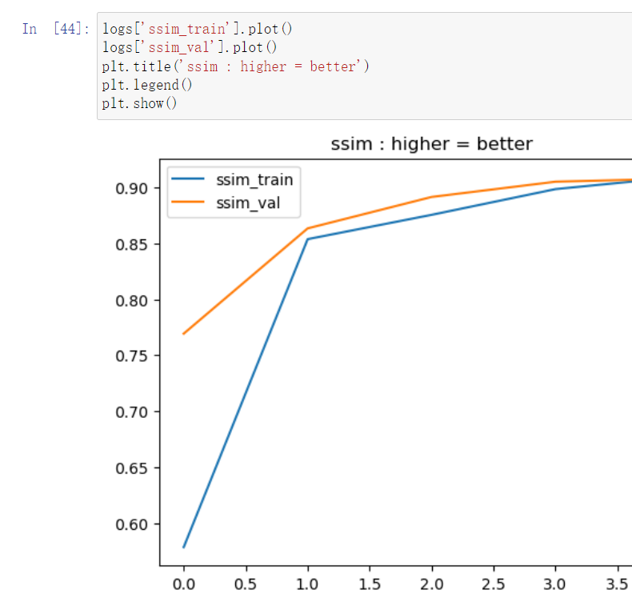
In Jupyter notebook show ssim result

Slide 14
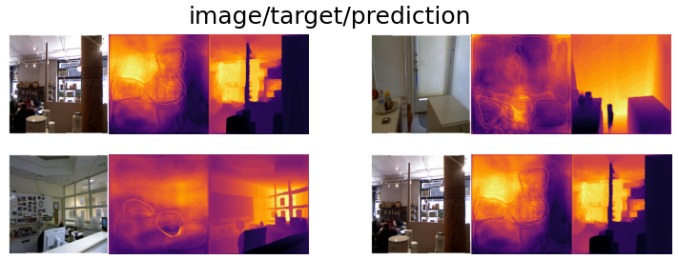
Have been done
To be done
Investigation in literature.
Reproduced the core experiments as well as the experiment partition of the work.
By Nov. 10, finish all the experiments and submit supplementary experiments.
By Nov. 21, finish the final script.

Slide 15
References
[1] Md Abul Bashar and Richi Nayak. Active learning for effectively fine-tuning transfer learning to downstream task. ACM Transactions on Intelligent Systems and Technology (TIST), 12(2):1–24, 2021. 2
[2] Andreas Geiger, Philip Lenz, Christoph Stiller, and Raquel Urtasun. Vision meets robotics: The kitti dataset. The International Journal of Robotics Research, 32(11):1231–1237, 2013. 3
[3] Jun Liu, Qing Li, Rui Cao, Wenming Tang, and Guoping Qiu. Mininet: An extremely lightweight convolutional neural network for real-time unsupervised monocular depth estimation. ISPRS Journal of Photogrammetry and Remote Sensing, 166:255–267, 2020. 2
[4] Siping Liu, Laurence Tianruo Yang, Xiaohan Tu, Renfa Li, and Cheng Xu. Lightweight monocular depth estimation on edge devices. IEEE Internet of Things Journal, 9(17):16168–16180, 2022. 2
[5] Elliot Meyerson and Risto Miikkulainen. Pseudo-task augmentation: From deep multitask learning to intratask sharing—and back. In International Conference on Machine Learning, pages 3511–3520. PMLR, 2018. 1 [6] Michael Moser, Michael Pfeiffer, and Josef Pichler. Domain-specific modeling in industrial automation: Challenges and experiences. In Proceedings of the 1st International Workshop on Modern Software Engineering Methods for Industrial Automation, pages 42–51, 2014. 2
[7] Michael Rudolph, Youssef Dawoud, Ronja G¨uldenring, Lazaros Nalpantidis, and Vasileios Belagiannis. Lightweight monocular depth estimation through guided decoding. In 2022 International Conference on Robotics and Automation (ICRA), pages 2344–2350. IEEE, 2022. 2
[8] Diana Wofk, Fangchang Ma, Tien-Ju Yang, Sertac Karaman, and Vivienne Sze. Fastdepth: Fast monocular depth estimation on embedded systems. In 2019 International Conference on Robotics and Automation (ICRA), pages 6101–6108. IEEE, 2019. 2
[9] Ning Zhang, Francesco Nex, George Vosselman, and Norman Kerle. Lite-mono: A lightweight cnn and transformer architecture for self-supervised monocular depth estimation. In Proceedings of the IEEE/CVF Conference on Computer Vision and Pattern Recognition (CVPR), pages 18537–18546, June 2023.

